Slide 1

Struktur Data
Multi-Dimensional Arrays
Prepared by
Frans Panduwinata, S.Kom, M.T

Slide 2

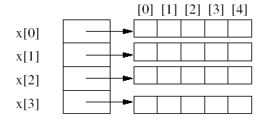
Two-Dimensional Array
Two-dimensional array is represented as a one-dimensional array in which each element is, itself, a one-dimensional array.
EXAMPLE:
The array int x[4][5];

Slide 3
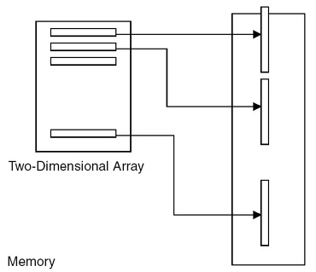
Two-Dimensional Array (cont)
Representation of two-dimensional arrays

Slide 4
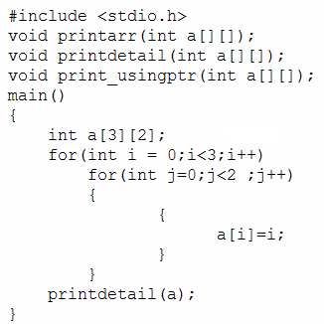
Two-Dimensional Array (cont)
EXAMPLE:

Slide 5
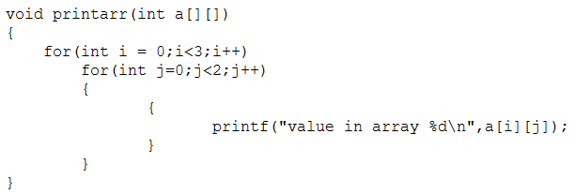
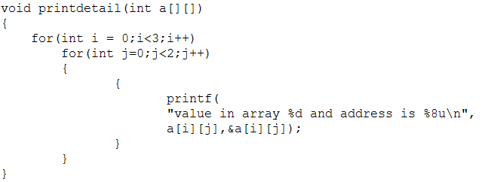
Two-Dimensional Array (cont)
EXAMPLE:
(cont)

Slide 6


Two-Dimensional Array (cont)
EXAMPLE of two-dimensional array implementation:
Transpose of a matrix.
The transpose of a matrix is obtained by interchanging the rows with the corresponding columns
void trans(int mat[][3],int tr_mat[][3], int k ,int l)
{
  int i,j;
  for(i=0;i<k;i++)
  for(j=0;j<l;j++)
  {
  tr_mat[i][j]=mat[j][i];
  }
  }
transpose

Slide 7
Three-Dimensional Array
Just as with a two-dimensional array, you can define three-dimensional arrays and processing in a similar way.
Each three-dimensional array is taken as an array of two-dimensional arrays.

Slide 8
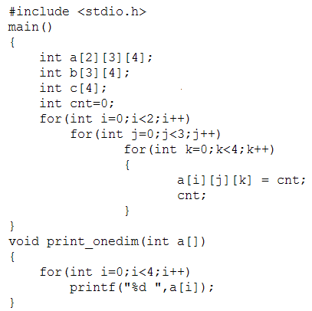
Three-Dimensional Array (cont)
EXAMPLE:

Slide 9
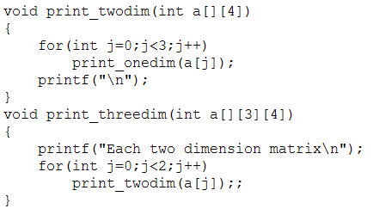
Three-Dimensional Array (cont)

Slide 10
Exercises
Write a program using 2-D Array and Functions to calculate
the sum of two matrix.
Matrix 1:
11 42 39
44 5 86
Matrix 2:
12 36 9
1 8 9
The Sum of Matrix 1 & Matrix 2:
23 78 48
45 13 95

Slide 11
Exercises (cont)
Write a program using 2-D Array and Functions.
Number of Row(s) : 2
Number of Column(s): 3
Row 1 Column 1: 1
Row 1 Column 2: 2
Row 1 Column 3: 3
Row 2 Column 1: 4
Row 2 Column 2: 5
Row 2 Column 3: 6
Your Data:
1 2 3
4 5 6
Sum Row(s) and Column(s):
1 2 3 6
4 5 6 15
5 7 9 21

Slide 12
Exercises (cont)
Write a program using 2-D Array and Functions.
Number of Row(s) : 5
Number of Column(s): 3
| 1 2 3
----------------
1 | 1 1 1
2 | 2 4 8
3 | 3 9 27
4 | 4 16 64
5 | 5 25 125

